Slide 1

FORCE AND PRESSURE
Submitted by Name - Pratik Srisant Toppo Class – 8C Roll.No – 42
Submitted to
Mrs.Rashmi Srivastava

Slide 2

Acknowledgement
I would like to express my special thanks of gratitude to my Physics teacher "Mrs. Rashmi Srivastava" for their able guidance and support in completing my project work I would also like to extend my gratitude to the Principal “Fr. Ignatius lakra S.J” for providing me with all the facility that was required.
Date – 1/08/2022 Pratik Srisant Toppo
Class – 8C

Slide 3
Table of Content
Introduction
Force
Turning effect of a force Page 1 Page 2
Factors affecting the turning effect of a body
Opening of door by push or pull
Movement of Force
Pressure
The effect of thrust

Slide 4
Table of Content continued
The effect of thrust Examples
The effect of thrust Examples continued
Definition of thrust
Units of Pressure
Consequences of liquid pressure
Conclusion
Bibliography

Slide 5
Introduction
A force is a push or pull upon an object resulting from the object’s interaction with another object. The turning effect of a force is more if the distance between the point of application of force and the hinge on a door is more. It is given a special name – Moment of force. Pressure is defined as force per unit area. Solids, liquids, and gases all exert pressure. The atmosphere also exerts pressure, activities are carried out to demonstrate that solid, liquid, and gases exert pressure.

Slide 6
Force
A force is a cause of ( push or pull ) which tends to result in movement or change in size or shape of the body. A force when applied as a push or pull on a stationary body that is free to move, can produce motion in it and if applied on a moving body, it can change the speed of motion of a body (i.e can speed up or slow down the moving body) or it can change both the speed and direction of motion. Similarly, the shape or size of a non-rigid body can also be changed by applying force. However, if an object does not move on the application of force or its size and shape do not change, then in the language of Physics, we say that force is not fruitful.

Slide 7
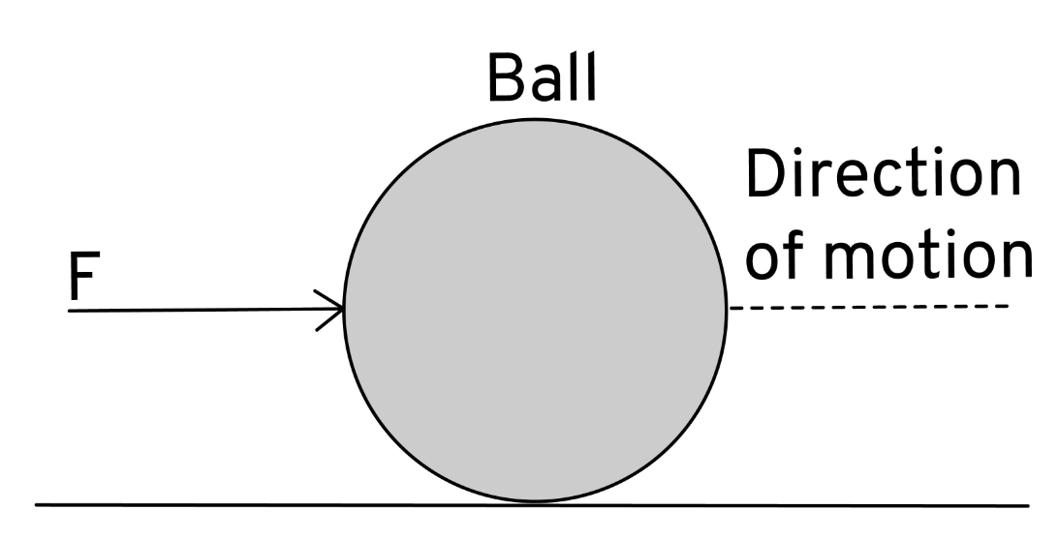
Turning effect of a force
Force is applied on a stationary rigid body, it starts moving on a stationary rigid body, it starts moving in a starting line in the direction of force as shown, a ball moves on a pushing.

Slide 8
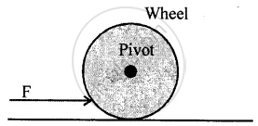
Turning effect of a force
Now if the body is not free to move, but it is pivoted a point O and a force F is applied at a suitable point A, it begins to turn about point O.
The Vertical axis passing through the point O about which the body turns is called the axis of rotation. In the diagram, on pushing, the wheel begins to turn about its pivoted point O.

Slide 9
Factors affecting the turning effect of a body
The turning effect of a force on a body depends on the following two factors :
1. The magnitude of the force applied.
Larger the magnitude of force applied, more is the turning effect on the body
2. The Perpendicular distance if the force from the pivoted point.
Large and Perpendicular distance of point at which the force is applied, from the pivoted point, more is the turning effect on the body.

Slide 10
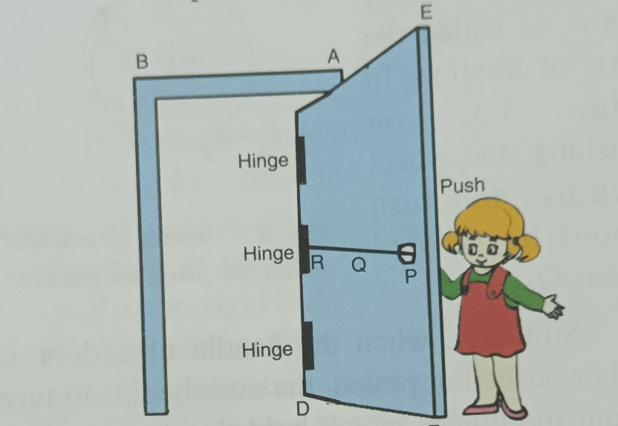
Opening of door by push or pull
To open or shut a door, we apply a force (push or pull) F normal to the door at its handle P which is provided at the maximum distance from the hinges as shown. We can notice that if we apply the force at a point Q (near the hinge R), much greater force is required to open the door and if the force is applied at the hinge R, we will not be able to open the door howsoever large the force may be. Thus, the hand P is provied near
the free end of the door that a smaller force at a
larger perpendicular distance, produces required
turning effect of force to open or to shut the
door.

Slide 11
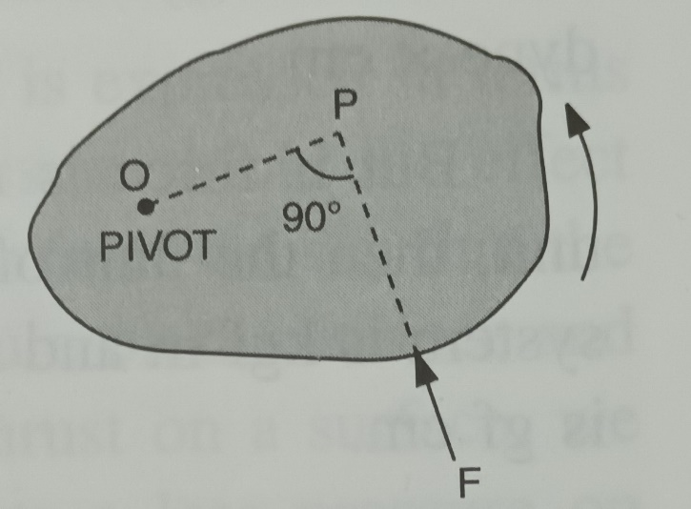
Movement of force
The movement of a force is equal to the product of the magnitude of the force and the perpendicular distance of the force from the provied point.
Consider a body which is provied at a point O. if a force F is applied on the body in the direction FP as shown. The force is unable to produce linear motion of the body in its direction because the body is not free to move, but this force turns (or rotes) the body about the
point O,in the direction shown by the arrow.

Slide 12
Pressure
Thrust – A force can be applied on a surface in any direction. If the force is applied on a surface in a direction normal (perpendicular) to the surface, the force is called thrust. Thus, the force acting normally on a surface is called thrust. A body, when placed on a surface, exerts a thrust on the surface equal to its own weight.
The unit of thrust is sane as that of the weight of force. Thus, the units of thrust are kilogram force (kgf), gram force (gf) and newton (N). These units are related as:
1 kgf = 1000gf
1 kgf = 10N (nearly)
1N = 100gf (nearly)

Slide 13
The effect of thrust
The effect of thrust depends on the area of the surface on which its acts. Smaller the area of the surface on which a thrust acts, larger is its effect. But the effect of a thrust is less on a large area.
Examples :

Slide 14
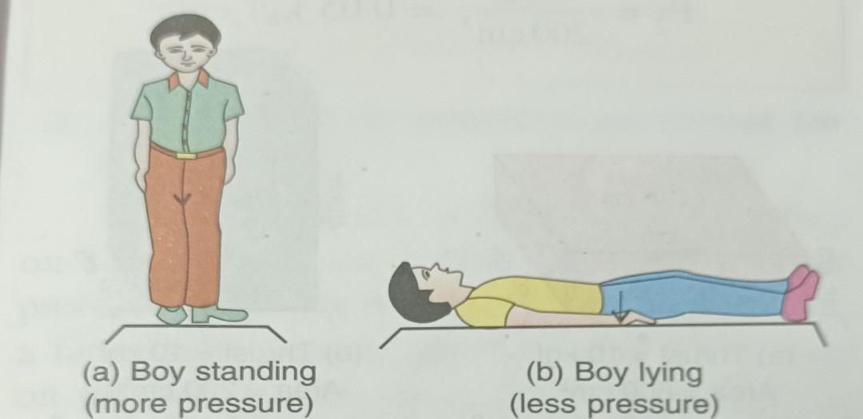
The effect of thrust Examples
If you stand on loose sand, your feet will sink deeply into the sand. But when you lie on the sand, your body does not sink much into the sand. In both cases, the thrust exerted on the sand is the same. The reason is that when you stand, the thrust acts on a smaller area, so you sink more in the sand, and when you lie down, the same thrust acts on a larger area, so you sink less in the sand.

Slide 15
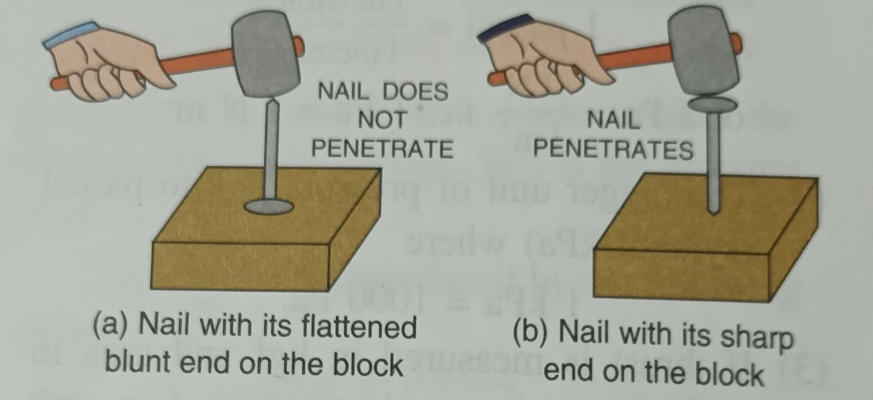
The effect of thrust Examples continued
If you hammer a nail holding it with its flattened and rusting on a wooden block, you find a difficult to get the nail into the block. But if you hammer the nail holding it sharp on rusting on the block, the nail penetrates into the block easily. The reason is that when thrust acts on the flattened end, the effect of thrust is small but when thrust acts on the sharp end, the effect of thrust is more.

Slide 16
Definition of Thrust
Pressure is defined as the thrust per unit are Thus,
It is denoted by the letter P.
If a thrust F acts on an area A, the pressure P is:

Slide 17
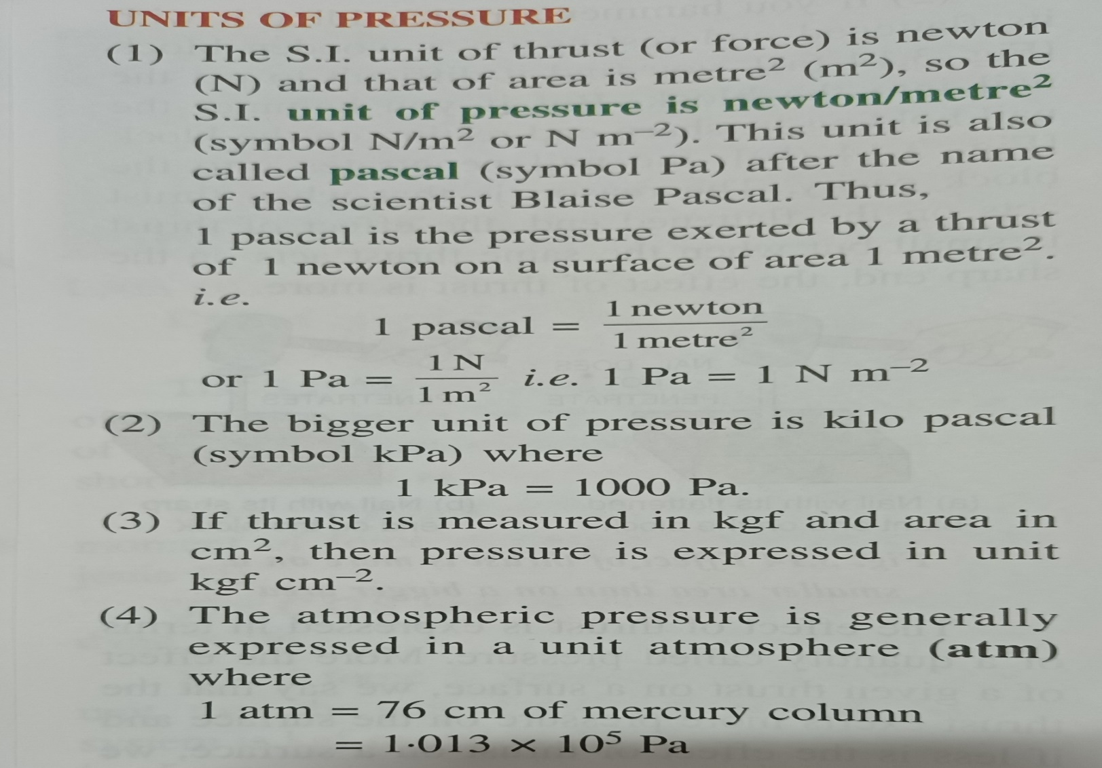
Units of Pressure

Slide 18
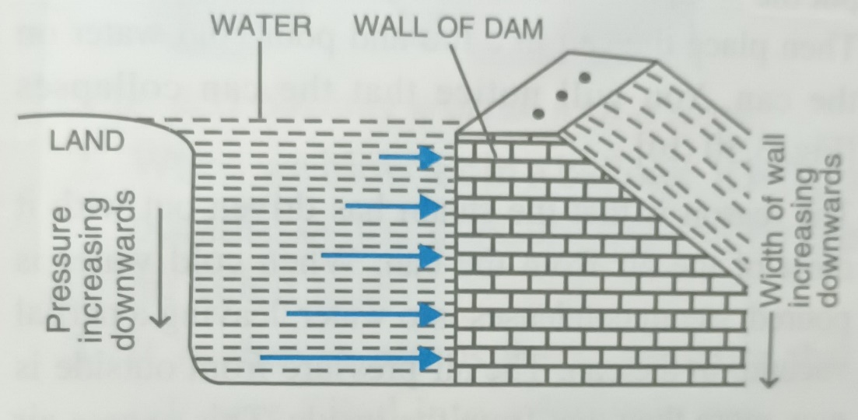
Consequences of liquid pressure
Thickness of walls of a dam is increased towers the bottom :
The reason is that the pressure at a point due to a liquid increases with the increase in height of the liquid column above it, so thickness of the walls of a dam is increased towards the bottom so as to withstand the increasing pressure of water. The arrows in the figure show the increasing pressure towards the bottom of the dam.

Slide 19
Conclusion
Here, I have come to the end of the project on the topic "FORCE AND PRESSURE".
I would like to share my experience while doing this project. I learnt many new things about force and pressure and it was a wonderful learning experience for me while working on this project. This project has developed my thinking skill and more interest in this subject. This project gave me real insight into the Physics world. A very special thanks to my dear Principal sir for setting such target for us. I enjoyed every bit of work. I put into this project. I do hope that my project will be interesting and maybe even knowledgeable.
THANK YOU..

Slide 20


Bibliography
I “Pratik Srisant Toppo of class 8’c’ have done this project with the help of my parents, my sister, and my friends.
I used –
Note book
Text Book of Physics
Website - https://pratik-project-source.github.io/physics
Copy of physics project download

